Slide 1
BOND PRODUCTS
21 DEC 2016

Slide 2
Section 1. Panda Bond Issuance
2

Slide 3
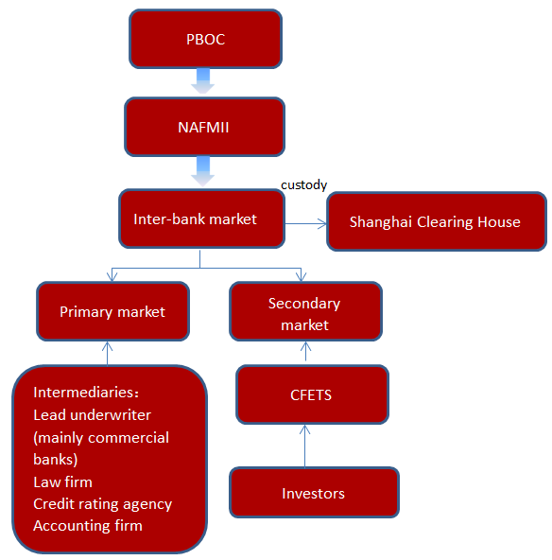
China Onshore Bond Market Overview
Bonds are issued and traded in two different markets in China - interbank market and exchange market.
Interbank market is an OTC market with institutions as major participants.
Exchange market involves both individual and institutional investors.
The interbank market has been playing the main role for the recent years with >95%
share .
Interbank Market Structure
The large selection of China’s Interbank market products mainly include:
Government bond
Central bank note
Local government bond
Financial bond
Corporate bond
International institution bond
Government-backed institutional bond
Medium-term note
Commercial paper
Asset-backed notes
Outstanding volume at
2015 Year End
Issuance in 2015
Trading volume in 2015
Source: NAFMII, Chinabond 2015

Slide 4
Onshore RMB Market
PBOC has undertaken a series of easing measures to stimulate economic recovery.
One-year benchmark lending rate was cut to 4.35% in last October.
Reserve Requirement Ratio (RRR) has been cut several times since last year.
PBOC will take more easing measures to keep adequate liquidity in the market with the aim to lower funding cost. Therefore, the yield on short tenor bonds is expected to remain steady.
Multiple Interest Rate Cuts by PBOC
RMB Benchmark Lending Rate
(As of 2015-10-24)
Primary Market Performance( 3 Year)
Type | YTM
Treasury bond | 2.43% (September 29)
Local government bond | 2.42% (September 29)
Policy bank | 2.79% (September 29)
Credit AAA Corp | 3.48% (September 28)
DATE | Deposit Rate | Lending Rate
2015-10-24 | ↓0.25% | ↓0.25%
2015-8-26 | ↓0.25% | ↓0.25%
2015-6-28 | ↓0.25% | ↓0.25%
2015-5-10 | ↓0.25% | ↓0.25%
2015-2-28 | ↓0.25% | ↓0.25%
2014-11-22 | ↓0.25% | ↓0.40%
 | Rate
Short-term
1 Year | 4.35%
Mid to long-term
1-5 Year | 4.75%
Over 5 Year | 4.90%
Secondary Market Performance (3 Year) On September 29
Type | YTM
Treasury bond | 2.3884%
Local government bond | 2.6084%
Policy bank | 2.7676%
Credit AAA Corp | 2.9763%
Source: Wind

Slide 5
History of Panda Bond
Definition
Panda Bond is a RMB-denominated bond issued by foreign institutions in China’s Bond Market.
2005
2006
2009
2013
2014
2015
2016
The first two Panda bonds were issued by IFC and ADB on the same date in October, with size of RMB 1.13 billion and 1 billion respectively.
IFC issued RMB 870 million panda bond.
ADB issued RMB 1 billion Panda bond to support clean energy projects in China.
Daimler AG registered RMB 5 billion, with Bank of China as the sole lead underwriter.
Daimler AG,
as the first corporate issuer, issued RMB 500 million panda bond and the second RMB 1 billion Panda bond.
Bank of China (Hong Kong) issued the first 1 billion financial panda bond in September
HSBC(HK) thereafter issued 1 billion financial panda bond.
Daimler AG issued its 5 billion RMB Panda bond.
China Merchants(HK) publicly issued the first 500 million panda bond.
Standard Chartered Bank issued 1 billion RMB Panda bond.
Republic of Korea issued 3 billion RMB Panda bond.
BC Province successfully issued RMB 3 billion Panda bond.
Chong Hing Bank issued 3-year maturity Panda bond with value of RMB 1.5 billion.
China Resources Land issued 3-year, RMB 2 billion and 5-year,RMB 3 billion Panda bonds.
Semiconductor Manufactory International Corporation (SMIC) issued 1 year, RMB 600 million and 3-year, RMB 1.5 billion Panda bonds.
Daimler AG: 4 billion RMB.
Republic of Poland Ministry of Finance: 3 billion RMB.
Veolia Environment: 1 billion RMB.
China Resources Cement: 3.5 billion RMB.
Hengan International: 2 billion RMB.
5

Slide 6
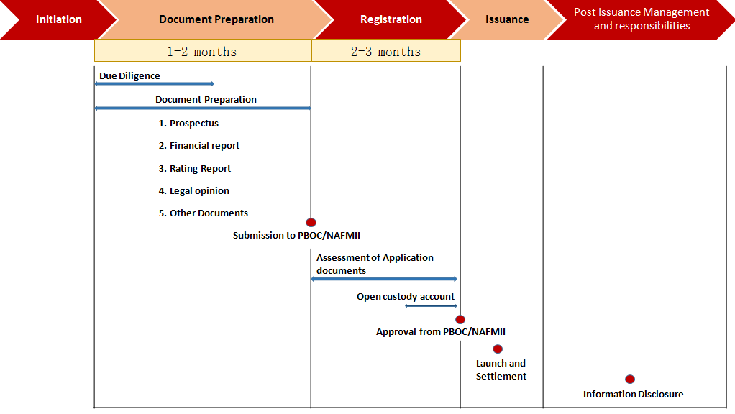
Issuance Time Frame
Registration and Issuance Procedure
Sovereign institutions should file to PBOC for application.
PBOC will assess the application materials and let NAFMII process the bond registration.
After registration approval by NAFMII, issuer can issue Panda Bond in China’s interbank bond market.
Valid period for registration is expected to be 2 years. Bonds can be issued all in once or in tranches within the valid period of registration.
*This timetable is a general guidance for the issuance and adjustable depending on the quality of the material preparations and communication with the regulators.
6

Slide 7
Advantages of Panda Bonds Issuers
By issuing innovative financial instruments, issuers can build better image in Chinese capital market.
Issuers can build a great interactive relationship with Chinese supervision institutions during the innovation period of Panda Bond.
Seize the opportunities of lower financing cost in the onshore RMB market ,create a whole new way of financing.
With a 2-year valid period of registration, finding timings to issue bonds is more convenient and elastic.
7

Slide 8
Essential of Issuance
Underwriter
The lead underwriter usually takes the responsibility of document preparation, book-building, and follow-up information disclosure.
Coordinate other intermediaries to complete the due diligence and documentation.
Work with the issuer and investors to determine the transaction structure and coupon rate.
Rating Agencies
Required to be rated by at least two credit rating agencies. At least one rating agency should be registered in mainland China and eligible to rate RMB bonds.
Six accepted Chinese rating agencies -China Credit Rating/ China Chengxin International/ Shanghai Brilliance Credit Rating & Investors Service/ China Lianhe Credit Rating/ Dagong Global Credit Rating/ Golden Credit Rating International.
Accounting
Standards
Prepare the Financial Statement in conformity with China Accounting Standard (CASs) or
Prepare the Financial Statement in accordance with Accounting Standard which is equivalent to the CASs affirmed by China Accounting Standard Committee.
Legal Service
General legal opinion by law firms registered in China.
Special legal opinion by law firm registered at located country or region.
8

Slide 9
Essential of Issuance
Issuance
Book-building
Repayment
Proceeds deposit into RMB special accounts or non-resident account (NRA)
Interests are usually repaid annually and principal repaid at maturity
Custodian
Issuer should open an custody account at Shanghai Clearing house.
Clearing House entrusts issuer to transact the agency services of principal and interest payment.
Follow-up Management
Issuers shall keep on disclosing periodic financial information and significant events before maturity date.
Private placement is only required to share information among investors.
9

Slide 10
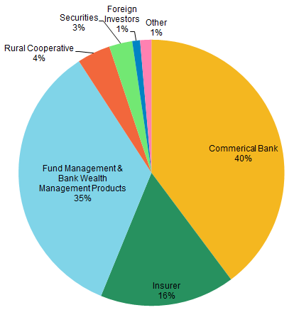
Investors Overview
Investors and maturity structure of the bond in interbank market
Investor Position in Credit Product Investment
Panda Bond is issued and traded in China’s Interbank Bond Market.
In the interbank market by the end of 2015:
Commercial bank account of around 40% of total investment in the credit products;
Asset management companies take around 35%.
Diversified maturity structure in the interbank market to meet investors’ financing needs.
Investors prefer medium and short term.
Source: Wind 2015
Maturity structure of the bond in interbank market by 2015 Year End
Source: Wind 2015
10

Slide 11
3.6 Recommendations - Bond Size & Tenor
Size: We recommend RMB 1 to 3 billions each tranche with MTN drawdowns.
Tenor: We recommend less than 5 Years under the current market condition; offering structure could be finalized before the launch date.
Major Considerations on Tenor
Match the Demands of Investors
Major investors in the China bond market are commercial banks, wealth management products, mutual funds and securities firms.
These investors prefer short to medium term,
such as 1y or 5y bonds, to match the duration of their liabilities.
Common Tenor in the China Bond market
Fulfill Issuer’s Demand for Funds
Use of proceeds will be varied, with a duration of 1 year to 5 years. The bond
tenor should match demanded funds’ duration to hedge interest rate risk.
Most bonds issued in China are less than 5 years.

Slide 12
3.7 Bond Pricing Factors
Major Considerations for Pricing
Investors
Credit Rating
Potential investors may include commercial banks, wealth management products, some mutual funds and securities firms, etc.
The issuer’s credit rating and financial fundamentals are the major factors to determine bond spreads over comparable policy banks financial bonds yield
Comprehensive Considerations to
Ensure Best Offering Price
Liquidity
Market Environment
The liquidity of the bonds in the secondary market is also considered
Monetary policies and capital market conditions also influence investors’ sentiment and demands

Slide 13
Bond Issue Proposal (recommended under current market conditions )
Tenor | 3Y(Recommended) | 5Y | 10Y
Issue Size | 2 - 3Billion | 1 - 1.5Billion | Currently only Chinese Government bond and Policy Bank Bonds fall in the 10 year tenor.
Local Rating: AA+ | 3.8 - 4.4% | 4.3 - 4.9%
Swap to USD | 3M Libor + 60- 120BPS | 3M Libor + 120 - 180BPS
Local Rating: AA | 4.2 - 4.8% | 4.6 - 5.2%
Swap to USD | 3M Libor + 100 - 160BPS | 3M Libor + 150 - 210BPS
+80BPS
13

Slide 14
Cost Structure
Items | Cost/Fee
Underwriting Fee [1] | Agreed upon discussion with Issuer (Including 10bp as the sales commission for the syndicate group)
Credit Rating Fee (For Issuer) [2] | RMB 100,000 - 150,000 (Agreed upon discussion with Issuer)
Credit Rating Fee (For Bond) | RMB 150,000 - 200,000 (Agreed upon discussion with Issuer)
Legal Service Fee(china) | USD 50,000-180,000 (Agreed upon discussion with Issuer )
Legal Service Fee(overseas) | Agreed upon discussion with Issuer
Custodian, Settlement and Clearing Fee | Based on issue volume (Less than RMB100,000 with RMB1 Billion issuance)
Tax | Based on issuer’s own situation
[1] Underwriting fee is negotiable on the case by case basis
[2] For sovereign issuers, there is no requirement for local credit rating, however, local credit rating is more meaningful for local China interbank market investors
14

Slide 15
Case——Republic of Poland Panda Bond Issuance
On 25 August 2016, the State Treasury of the Republic of Poland represented by the Ministry of Finance successfully issued its first ever Panda Bond in China’s domestic Inter-Bank Market.
Bank of China acted as the Joint Lead Manager and Lead Bookrunner and distributed over RMB 2.1 Billion of bonds, about 70% of total issue size. This has been the first time Republic of Poland issued RMB-denominated treasury bonds and also the first time a sovereign state in Europe issued panda bonds on the Chinese market. The issue received enthusiastic welcome of both domestic and foreign investors.
Order book of the 3-year-fixed RMB 3 billion Panda Bond was over RMB 5.9 billion, about 2 times over- subscribed. Investors included state-owned banks, commercial and foreign banks, mutual funds/asset managers, and offshore investors.
Key issuing clause
Issuer | The State Treasury of the Republic of Poland | Law | PRC Law | Joint underwriter &joint bookrunner | BOC
Issue size | 6000 Million | Currency | RMB | Issuance pattern | Public Placement
Credit Ratings | AAA by CCXI | Clearing | Shanghai Clearing House | Listing | CIBM Listing
1st period Issuing amount | 3000 million | Maturity | 3 years | Issuance date | Aug, 2016
15

Slide 16
Section 1 Panda Bond Issuance
Purpose
To choose Bank of China as Underwriter of Panda Bond and issue RMB Bond in China’s Onshore Market.
Target
Ministries of Finance in Africa
Banks
Large scale and high quality enterprises
Customer Relationship Departments are responsible for introducing our bank’s advantage initially.
FMD is responsible for communicating with HO and prepare for relative materials.
Division
16

Slide 17
Section 1 Panda Bond Issuance
Measures
Currently Focus: Africa Development Bank, Nano-Ministry of Finance, National Treasury of South Africa.
Africa Development Bank has intension to issuance with support of PBOC and our H.O. But it has many choice, FMD keeps watching and feedback to H.O. in time.
Nano-Ministry of Finance had a greater interest in issuance of Panda Bonds, but need further understand China’s Market. FMD should contact regularly, sending market information, guiding demand and collecting feedback.
The National Treasury of SA is mainly limited by the shorter issuance period. FMD collects market information, feedback when it favourable. To manage a breakthrough.
For other potential customers, customer relations departments market initially, then FMD follow up.
17

Slide 18
Section 2. Investment in China’s Bond Market
18

Slide 19
Organizational Framework of Interbank Bond Market
The People’s Bank of China (PBOC)
Regulator
Dealing and settlement agent of overseas central banks or monetary authorities in the interbank bond market
The China Foreign Exchange Trading System (CFETS)
Also known as National Interbank Funding Center
Providing systems for RMB lending and bond trading
China Central Depositary Trust & Clearing Co. Ltd. (CCDC) & Shanghai Clearing House (SHCH)
Centralized depositary and settlement for the interbank bond market
SHCH began to provide settlement services of SCPs on Dec. 21, 2010
National Association of Financial Market Institutional Investors (NAFMII)
Self-discipline organization
Conducts bond issuer access management

Slide 20
Infrastructure Framework of Interbank Bond Market
Trading Platform
Domestic Currency Trading System
Trading Hours: 9:00 – 12:00, 13:30 – 16:30, Beijing Time, from Monday to Friday, public holidays excluded
Depositary and Settlement Platform
Client Terminal Systems of CCDC and SHCH
Settlement speed (Order Deadline) : T+0（11:30am), T+1(16:00pm)
Cash Clearing Platform
China National Automatic Payment System
Settlement mode: DVP

Slide 21
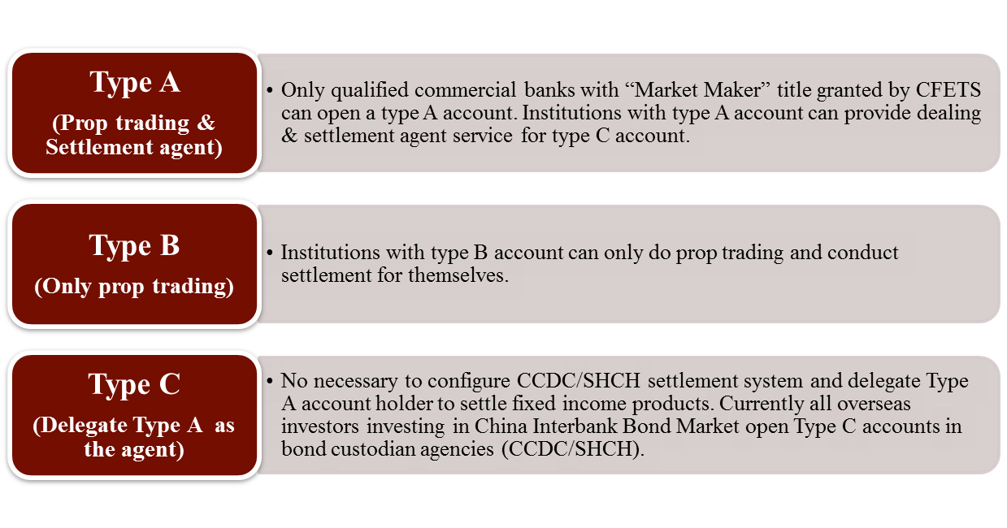
Types of Accounts in CCDC/SHCH
Notes:
待确认

Slide 22
Market Opening Policy — Development of Policy
Three types of eligible foreign institutions allowed to trade in the interbank bond market
QFIIs allowed to invest in CIBM
PBOC announced to open CIBM to foreign institutional investors, removing bond investment quota limits on qualified foreign institutional investors and simplifying market access
RQFII system introduced
PBOC signing currency swap agreement with monetary authorities or foreign central banks
2008 2009 2010 2011 2012 2013 2014 2015 2016
RQFII allowed to invest in CIBM
Overseas clearing banks and participant banks allowed to do repo in CIBM
Regulation on Cross-Border RMB Trade Settlement Pilot Scheme rolled out
Some overseas insurance companies allowed to participate in CIBM
PBOC published notification on allowing foreign Central Banks, Sovereign Funds and Multinational Financial Organization to invest into CIBM & CIFM

Slide 23
Market Opening Policy — CIBM Deregulation
PBOC’s July 2015 Notice: Further Relaxing Regulatory Restriction on the Access to CIBM by Investors
 | Before | After
Regulation | Approval-based | Registration-based
Principal Limit | Quota | No Limit
Instruments | Cash Bond | Cash Bond, Bond Repurchase, Securities Lending, Bond Forward, Interest-rate Swap, Forward Rate Agreement and Other Products Approved by PBOC
Trade Execution and Settlement Agent | Compulsory (through PBOC) | Market-based and service-driven Choice: PBOC or any of the Designated Commercial Banks

Slide 24
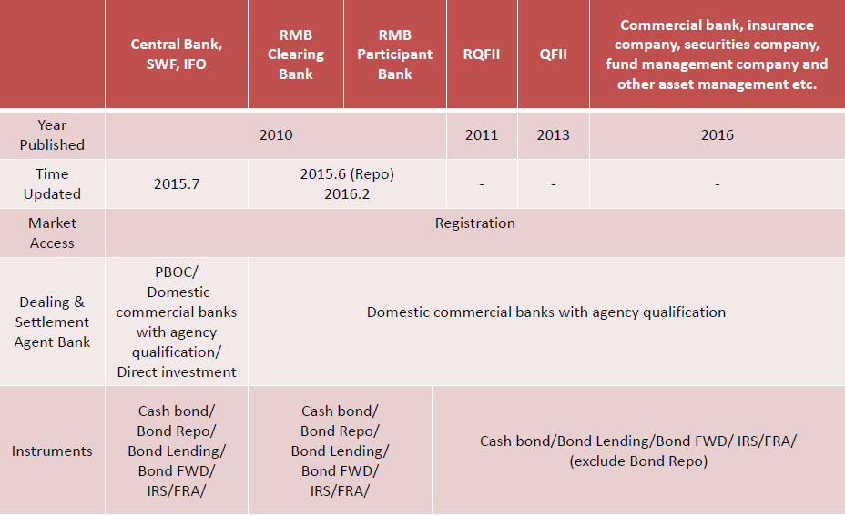
Market Opening Policy — Current Policy Scheme
24

Slide 25
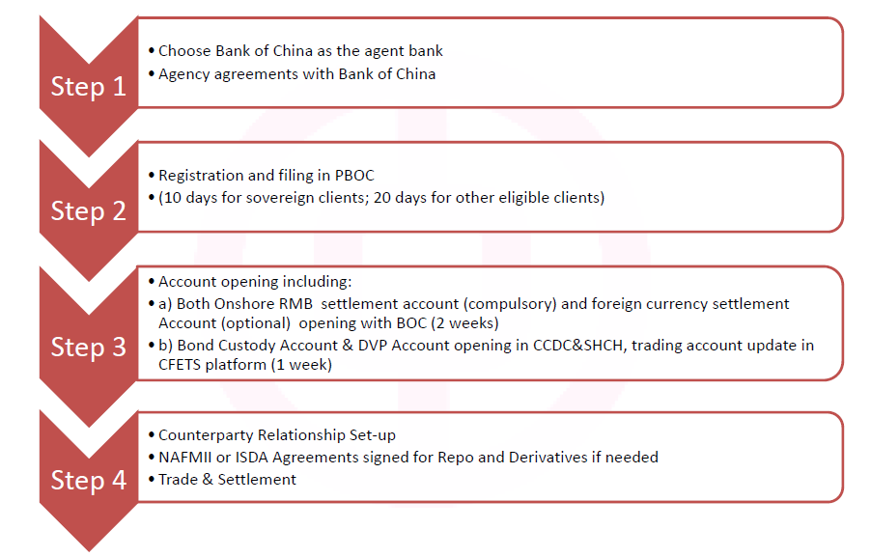
Market Entry – Access to CIBM

Slide 26
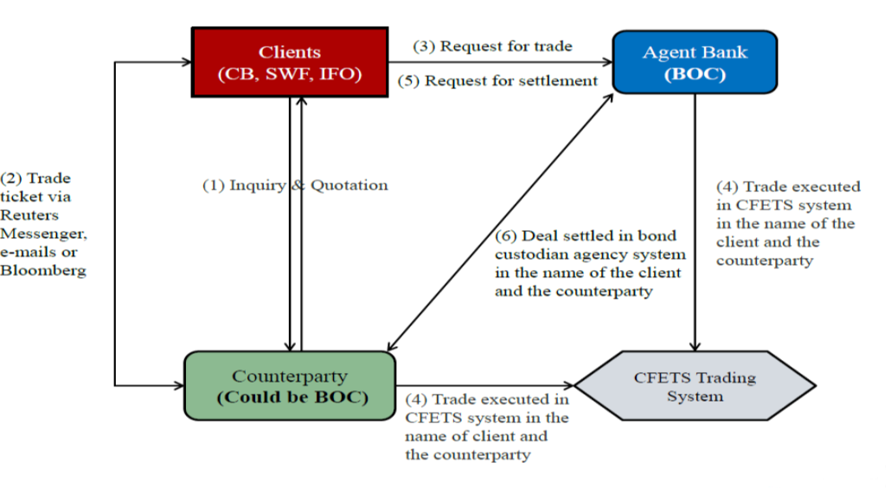
2.6 Market Entry -Workflow of Trade

Slide 27
Section 2. Investment in China’s Bond Market
Purpose
To choose Bank of China as an Bond Settlement Agency and as a trade counterparty in China’s Onshore Market.
Target
Central Banks in African , Commercial Banks, Fund Management companies
Customer Relationship Departments are responsible for introducing our bank’s advantage initially.
FMD is responsible for following up marketing and communicating with HO and customers, as well as works related to opening account in onshore branches.
Division

Slide 28
Section 2. Investment in China’s Bond Market
Measures
Currently Focus: South Africa Reserve Bank, Africa Development Bank, Bank of Namibia, Africa Development Bank .
Potential customers to tap: Neighbouring central banks, South African financial institutions, investment companies
Customer relations departments initiate marketing and feedback, FMD then follow up.

Slide 29
Section 3. Overseas Bond Sales
29

Slide 30
Section 3. Overseas Bond Sales
Business
The head office and the Hong Kong branch issue overseas bonds, branch marketing local customers
Condition
The branch shall have a bond sales license
Target
Local banks and asset management companies
FMD is responsible for communicating the head office, sending product information to business dept., marketing with the customer manager, collecting product information and customer marketing. The customer relations departments are responsible for seeking and marketing the target customers.
Division
30

Slide 31
Section 4 Overseas fund management

Slide 32
Section 4 Overseas fund management
Produces
Sold by head office, Such as UCTIS UCITS(Undertakings for Collective Investment in Transferable Securities),SIF(Specialised Investment Funds),Structured Notes
Condition
The branch shall have a license to sell the product
Target
Local banks and asset management companies
Division
FMD is responsible for communicating with the head office and product information unit, marketing together with the customer manager, and responsible for collecting product information and customer marketing progress. The customer relationship departments is responsible for seeking and marketing the target customers.

